Slide 1
4x4 – 3x3 Stage and Parity
COLL 134
Week 12

Slide 2
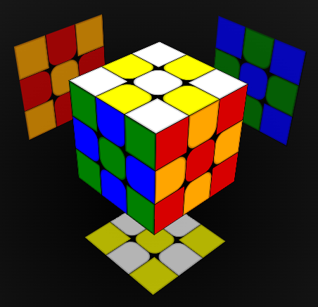
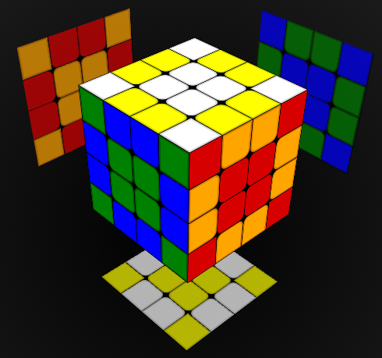
Final Steps!
After finishing centers and edges:
Double check color scheme
Then:
Solve it like a 3x3

Slide 3
What is Parity? (In Math)
Parity = Even vs Odd (integers only)
Even parity: -10, 0, 2, 46
Odd parity: -27, 1, 55
Even permutations = even number of swaps
Permutation to convert A-B-C to B-C-A:
A-B-C (swap A and B) → B-A-C (swap A and C) → B-C-A
Odd permutations = odd number of swaps
Permutation to convert A-B to B-A:
A-B (swap A and B) → B-A

Slide 4
3x3 vs 4x4 Behavior
On 3x3:
Face turns perform an even number of swaps → All 3x3 permutations/puzzle states are even
On 4x4:
Outer layer (face) turns perform an even number of swaps
Inner layer (slice) turns perform an odd number of swaps
4x4 permutations/puzzle states can be even or odd
Even + Even = Even Odd + Odd = Even Even + Odd = Odd
3x3 and 4x4 4x4 only 4x4 only

Slide 5
#1
Outer layer (face) turn
3 corner swaps
+ 3 left edge swaps
+ 3 right edge swaps
+ 3 center swaps
= 12 total swaps
#1
#1
#2
#1
#2
#2
#3
#2
#3
#3
#3
#1
Inner layer (slice) turn
3 edge swaps
+ 3 left center swaps
+ 3 right center swaps
= 9 total swaps
#1
#1
#2
#2
#2
#3
#3
#3

Slide 6
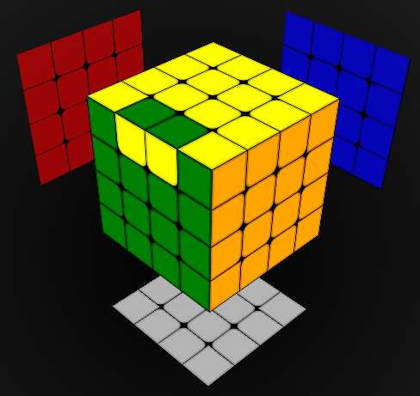
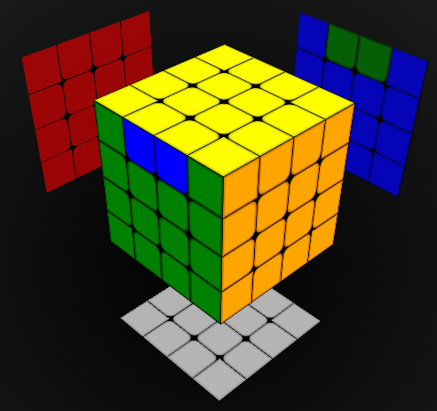
“Parity” on 4x4
Colloquial meaning of parity: cases not encountered on 3x3
2 types on 4x4, commonly known as OLL parity and PLL parity
OLL parity
PLL parity

Slide 7
Parity Theory
OLL Parity = swap 2 edge pieces
Odd number of swaps = odd puzzle state under OLL Parity
OLL Parity algorithms always use an odd number of inner layer quarter turns
PLL Parity = swap 4 edge pieces
Even number of swaps = even puzzle state under PLL Parity
PLL Parity algorithms always use an even number of inner layer quarter turns

Slide 8
OLL Parity
Using slice turns: 2R2 B2 U2 2L U2 2R' U2 2R U2 F2 2R F2 2L' B2 2R2
9 slice quarter turns
Odd puzzle state
Even puzzle state
3 swaps

Slide 9
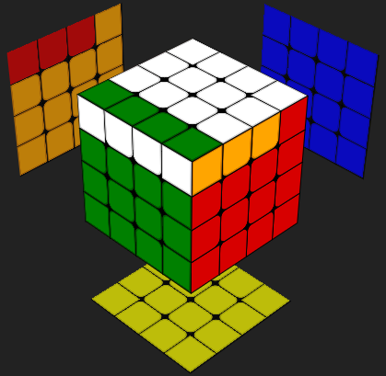
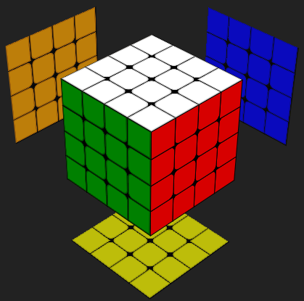
OLL Parity
Using wide turns: Rw2 B2 U2 Lw U2 Rw' U2 Rw U2 F2 Rw F2 Lw' B2 Rw2
9 slice quarter turns
Odd puzzle state
Even puzzle state
#1
9 swaps
#2
#3

Slide 10
OLL Parity
“Supercube safe”:
2R’ U’ 2U 2R U’ 2R U 2R 2U’ 2R’ 2U 2R U 2R U’ 2R Uw’ 2R’ U2
13 slice quarter turns
Odd puzzle state
Even puzzle state
1 swap

Slide 11
PLL Parity
Simplest algorithm: 2R2 U2 2R2 Uw2 2R2 2U2
10 slice quarter turns
Even puzzle state
Even puzzle state
4 swaps

Slide 12
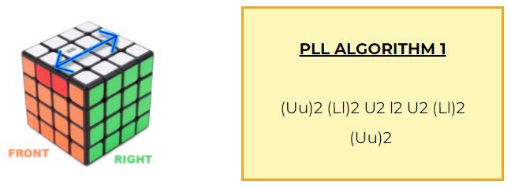
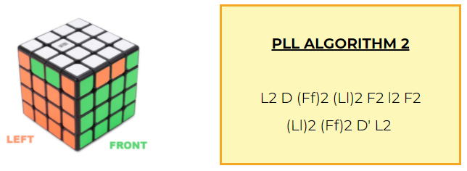
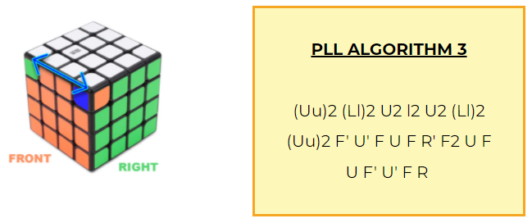
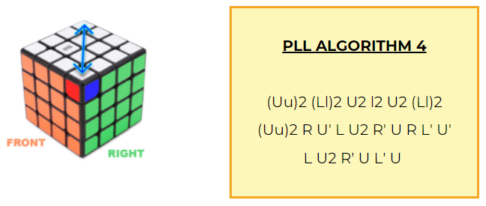
PLL Parity Variations
DIFFERENT NOTATION:
(Uu) = wide turn U = outer layer turn u = inner layer turn
https://www.kewbz.co.uk/blogs/solutions/4x4-parity-algorithms-oll-pll-algs-how-to-solve-a-4x4-rubiks-cube

Slide 13
Parity Recognition
OLL Parity:
Both ELL/CLL and OLL/PLL start with yellow cross
Only 1 or 3 yellow cross pieces facing up = OLL parity
PLL Parity:
Harder to detect than OLL parity
Count PLL swaps, odd number of swaps = PLL parity
Or:
Do as many LL steps as possible
Unable to progress past a certain step = PLL parity

Slide 14
Relevant Resources
4x4 Group Theory
Twisty Puzzle Parity Theory
4x4 Parity Algorithms Analysis

